Slide 1


VITE CAB
YOUR TAXI IN ONE CLICK

Slide 2
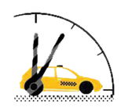

INTRODUCTION
Android app for online taxi service
App has two interfaces:
Customer interface
Taxi Driver interface
Helps customers in selecting an appropriate taxi nearby
Helps taxi driver to find his customer easily

Slide 3
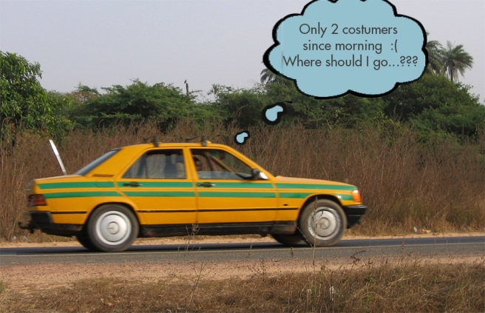
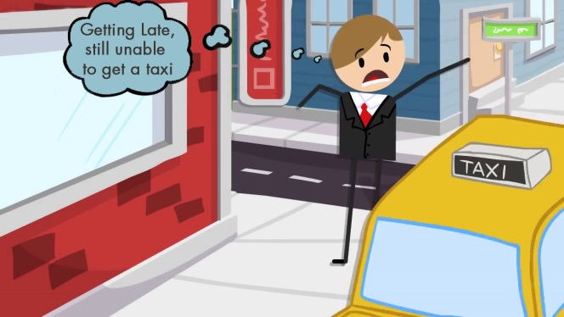
PROBLEMS
Major problems with the present taxi service are:
Wastage of time
Wastage of money
Insecurity of costumer
No check and balance of cab system

Slide 4
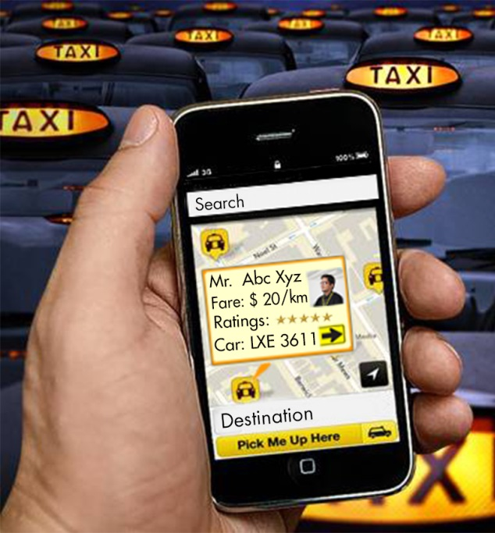
SOLUTION
Android app for communication between
customer and taxi
Customer can see nearby taxis on his map
Information regarding each taxi can be
seen by tapping taxi marker on the map
Customer will send his destination address to the taxi he selected

Slide 5
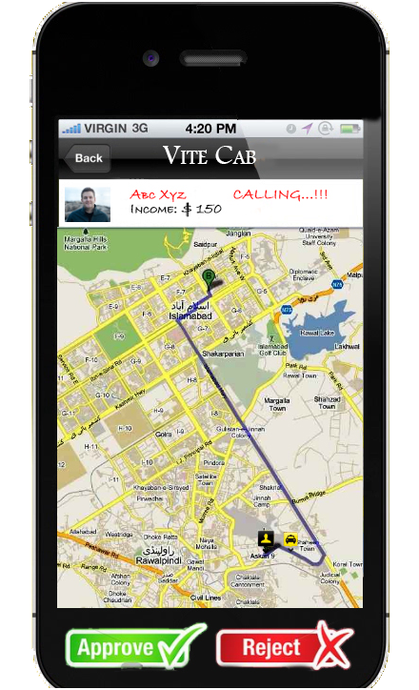
SOLUTION (cont.)
Customer’s current address and destination along with route will pop-up on the map at driver’s end
Driver can accept or reject the customer
Now user can track his approaching taxi in real time

Slide 6
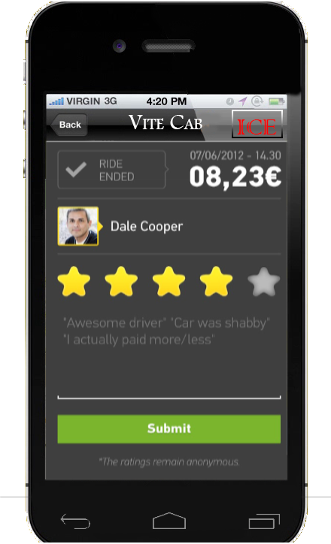
ADDITIONAL FEATURES
Customer will have the option to rate the driver at the end of journey
Fare will be displayed on screen to avoid inconvenience between costumer and driver
ICE (In Case of Emergency) button will also be added on the front screen of customer interface to ensure safety

Slide 7
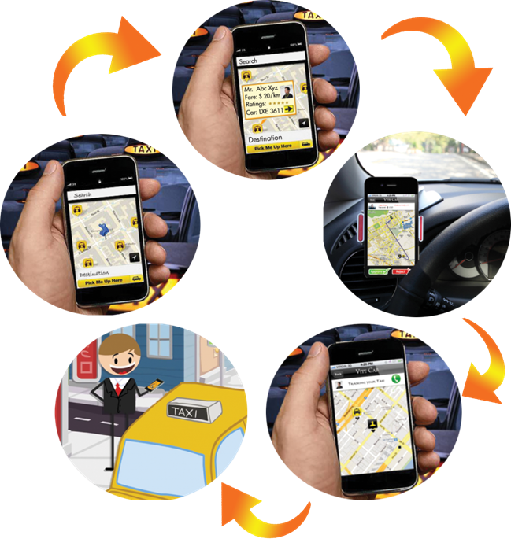
SCREENSHOTS

Slide 8
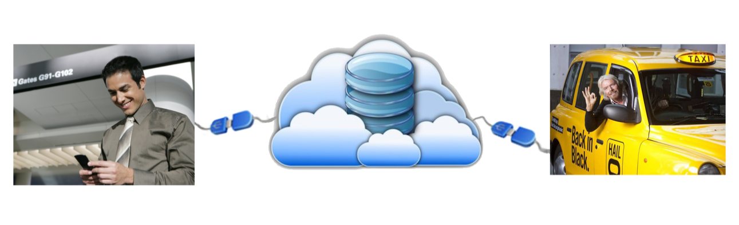
IMPLEMENTATION
Google maps API
Google cloud datastore
Google Cloud Messaging
SQLite (for querying datastore)

Slide 9

BENIFITS
Time saving of both the
customer and the taxi driver
Fuel saving for driver
User has to select his taxi based on fare and ratings, resulting in cheaper, safer and better standard transport
Finally we can have a properly organized taxi system

Slide 10

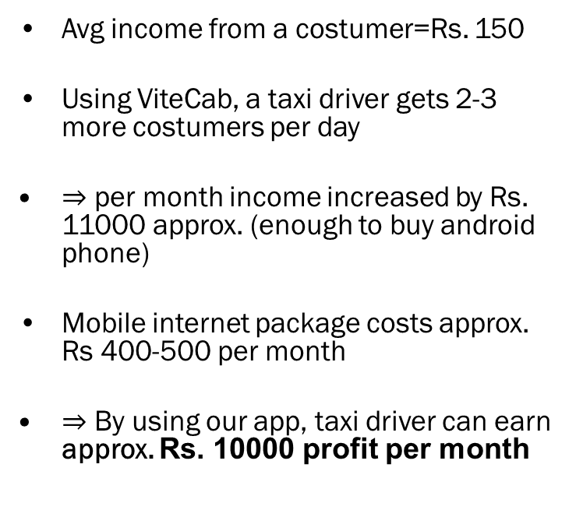
APPLICABLE IN PAKISTAN
Avg income from a costumer=Rs. 150
Using ViteCab, a taxi driver gets 2-3 more costumers per day
$⇒$ per month income increased by Rs. 11000 approx. (enough to buy android phone)
Mobile internet package costs approx. Rs 400-500 per month
$⇒$ By using our app, taxi driver can earn approx. Rs. 10000 profit per month

Slide 11

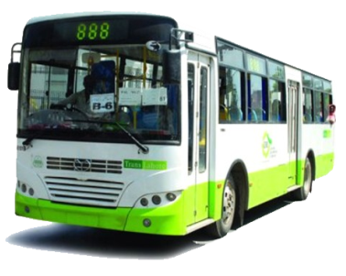

POSSIBLE MODIFICATIONS
This app tracks all the taxis which means it can be easily modified into real-time fleet tracking system
Can be implemented on local transport (e.g. LTC) to save the time of their users
Can be sold to taxi companies (e.g. Metro Cab) all over the world

Slide 12
CONTACT
Arslan Ahmed
+92 323 7749989
arslan.m.ahmed@gmail.com
SEECS, NUST
Faran Ahmed
+92 321 6025506
12besefahmed@seecs.edu.pk
SEECS, NUST

